Slide 1
Network Programming
Computer Network Review
School of Information and Communication Technology,
Hanoi University of Science and Technology

Slide 2
References
[1] W.Richard Stevens, Unix Network Programming Vol.1, 3rd Ed., Prentice Hall.
[2] Keir Davis, John W. Turner, and Nathan Yocom, The Definitive Guide to Linux Network Programming, Apress.
[3] Michael Donahoo, Kenneth Calvert, TCP/IP Sockets in C: Practical Guide for Programmers, Elsevier.

Slide 3
Content
Computer Networks
OSI and TCP/IP models
Internet Protocol (IP)
Transport layer, TCP, UDP
Network application models
Socket concept

Slide 4

















Computer Networks
Inter-connection of nodes by transport medium following some architecture:
  Using a topology: bus, star, ring, hybrid…
  Using some communication protocols
mobile network
global ISP
home
network
regional ISP
institutional
network

Slide 5
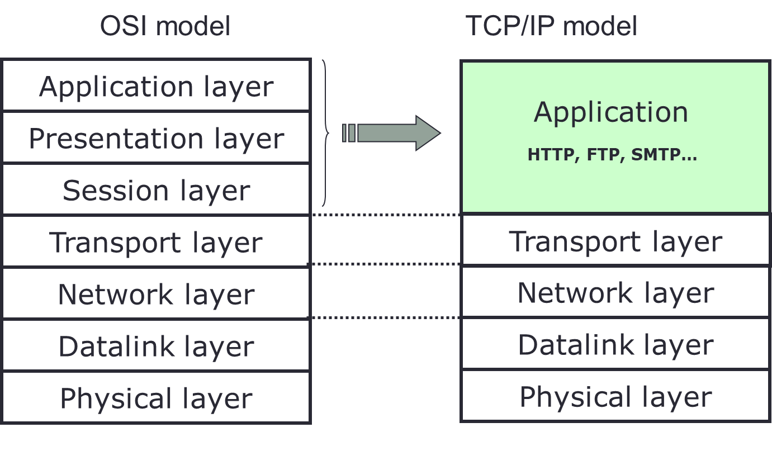
OSI and TCP/IP models

Slide 6
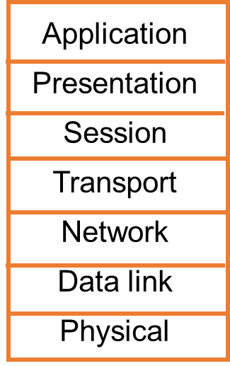
OSI and TCP/IP models
Application layer: defines communication between different parts of the same application
  Presentation layer: application data representation, data encryption, compression, conversion…
  Session layer: manages sessions, synchronization, recovery of data transmission process
Transport layer: Transmits data between applications
Network layer: Transmits data between distance network elements: Taking care of routing and forwarding data
Data link layer: Transmits data between adjacent network elements.
Physical layer: Transmits bits on the medium. Converting bits to physical form appropriate to the medium.

Slide 7
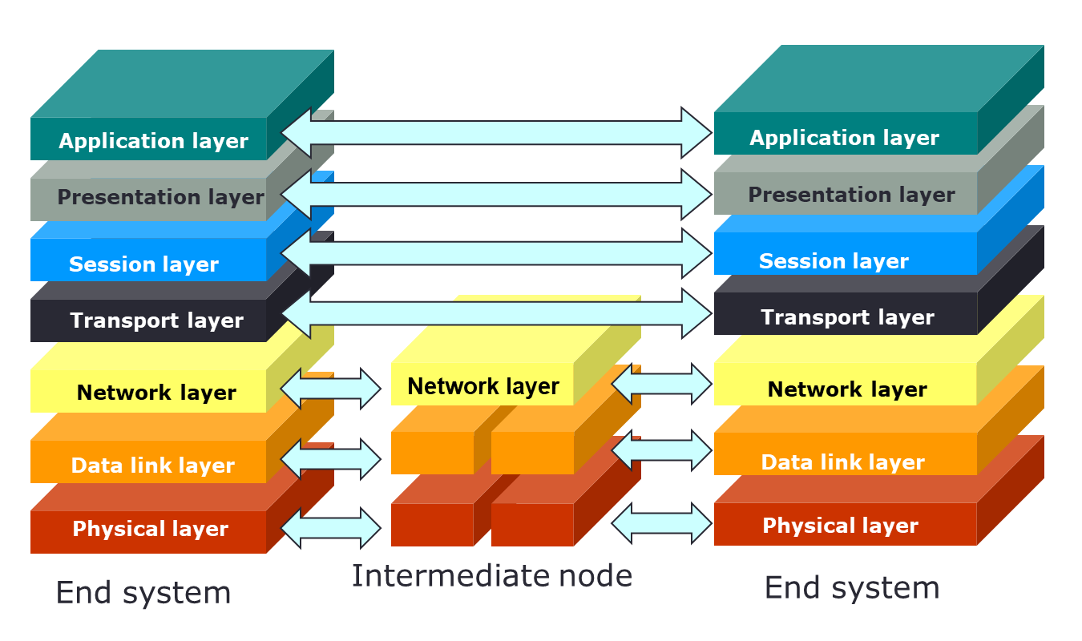
OSI and TCP/IP models
OSI model: reference model
TCP model: Internet model
  Transport layer: TCP/UDP
  Network layer: IP + routing protocols.

Slide 8
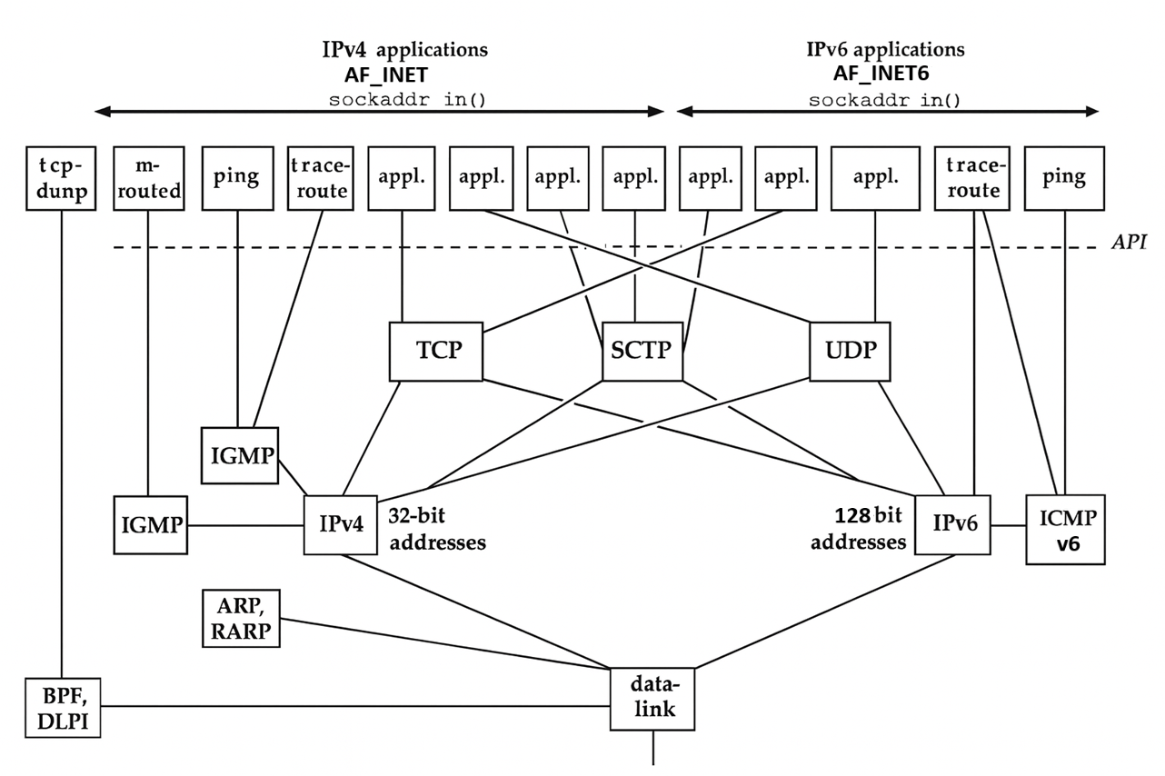

Slide 9
OSI and TCP/IP models
Layering Makes it Easier
Application programmer
  Doesn’t need to send IP packets
  Doesn’t need to send Ethernet frames
  Doesn’t need to know how TCP implements reliability
Only need a way to pass the data down
  Socket is the API to access transport layer functions

Slide 10
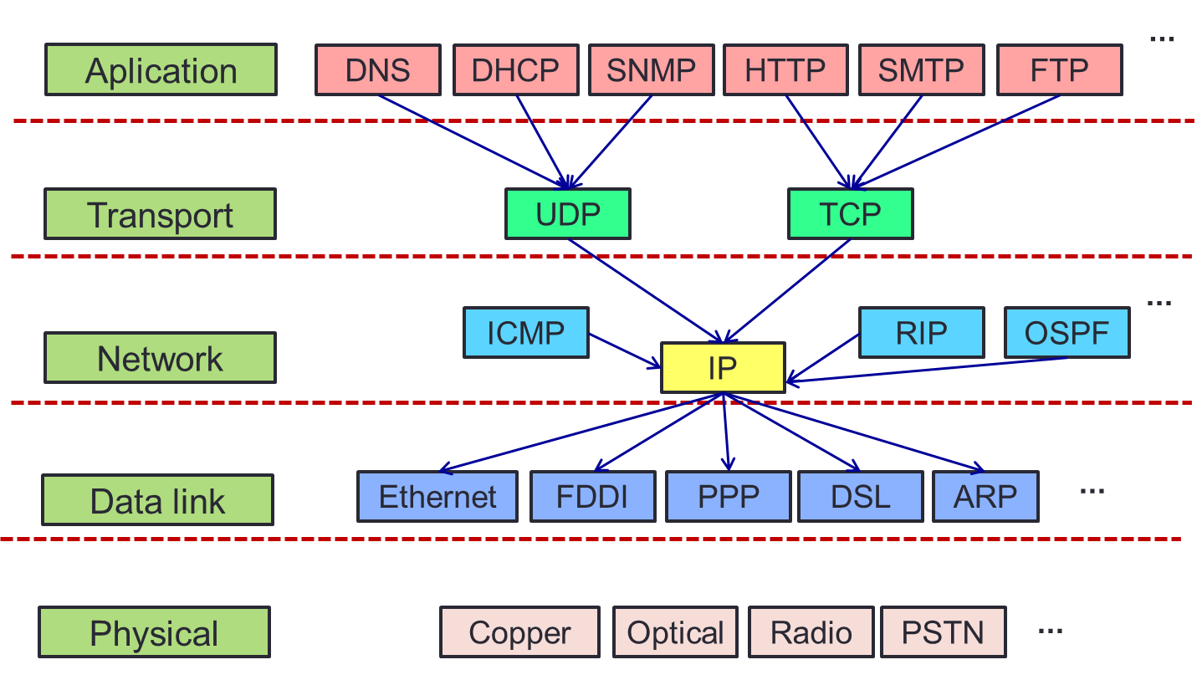
Internet protocols mapping on TCP/IP
PING

Slide 11
Internet Protocol (IP)
IP: Internet Protocol
  Forward data packet between distance network nodes (routers or hosts)
  Using routing table built by routing protocols such as OSPF, RIP …
IP address
  Is assigned to each network interface
  IP v4: 32 bits
    133.113.215.10
  IP v6: 128 bits
    2001:200:0:8803::53
A host may have a domain name
  Conversion IP <-> domain name: DNS
  Ex: soict.hust.edu.vn <--> 202.191.56.65

Slide 12
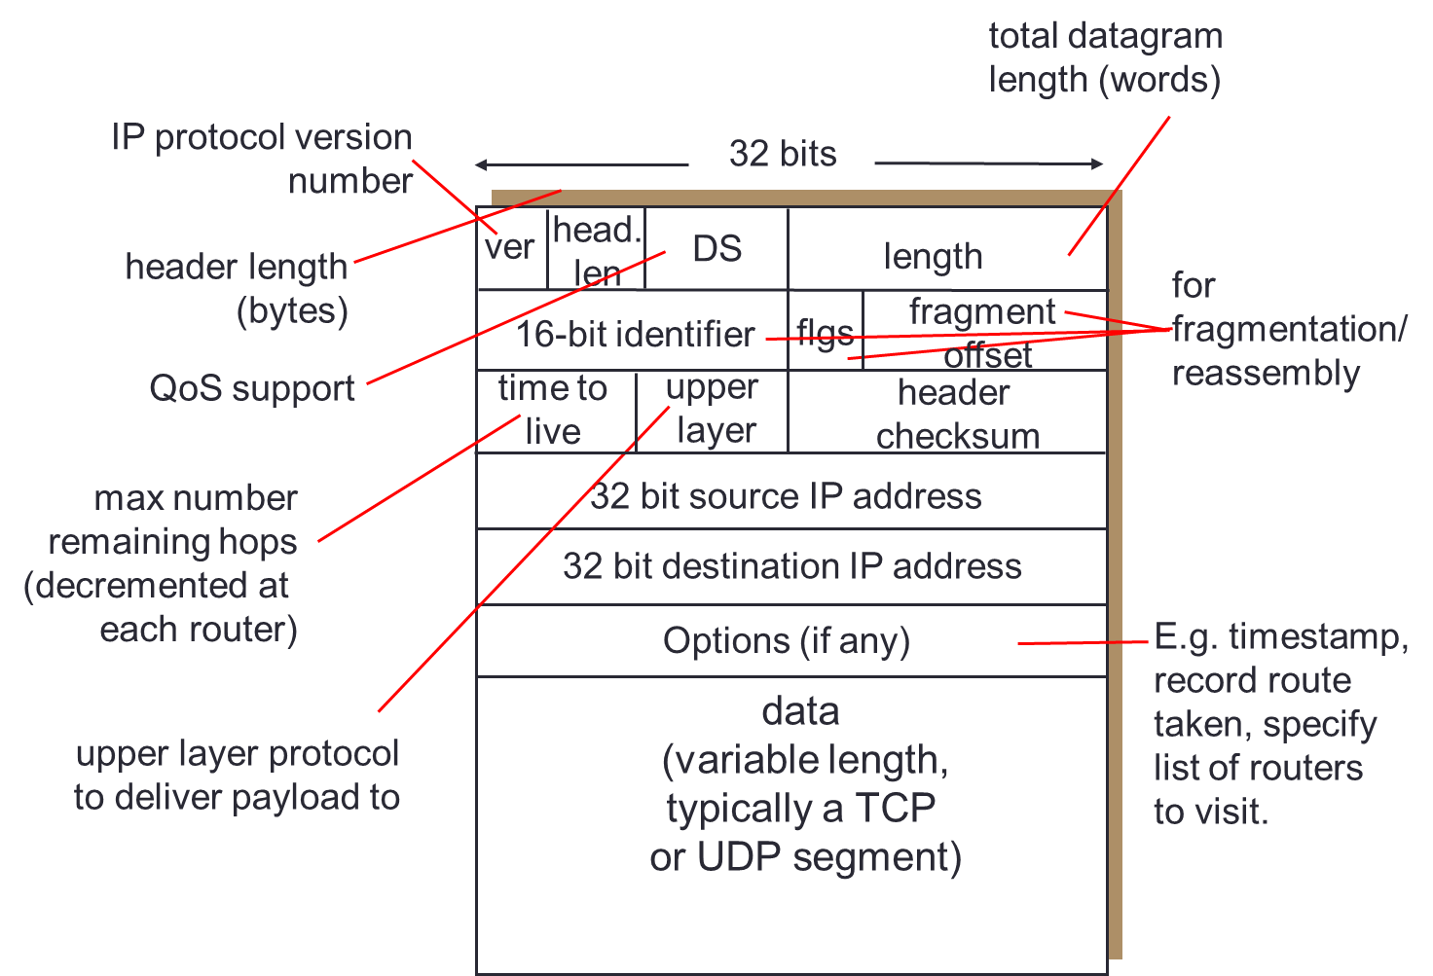
IP Packet

Slide 13
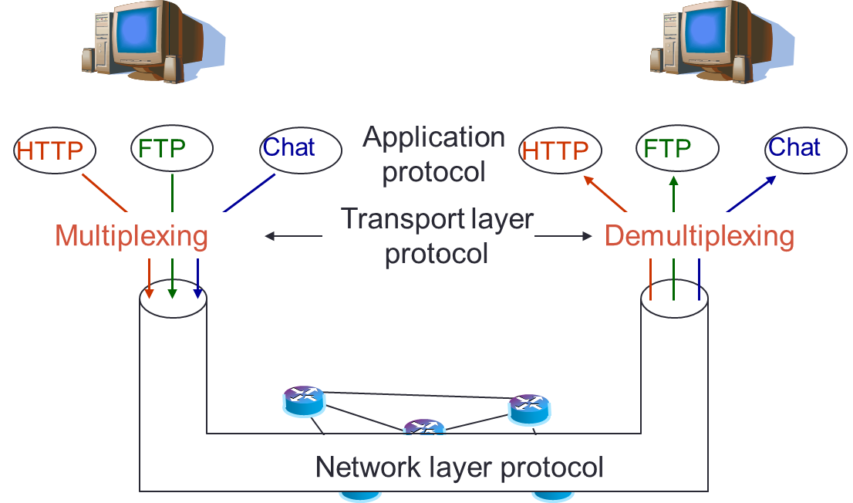
Transport Layer

Slide 14
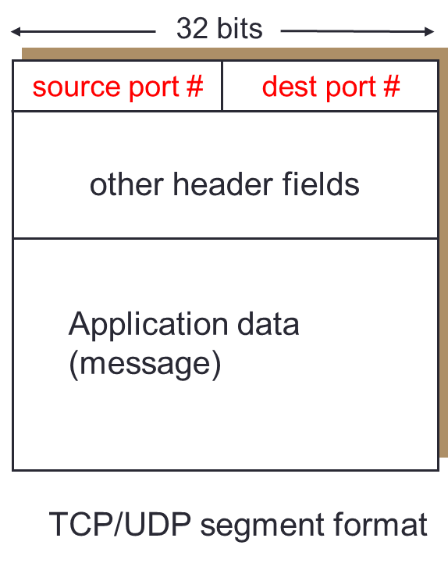
Transport Layer
How data from different applications between two hosts can be delivered to right application?
  Each application process is assigned a transport port (16 bits)
  Application sends data to the transport layer through the port.
Socket:
  Application access point for application
  It is a combination of (Address IP, transport port)

Slide 15
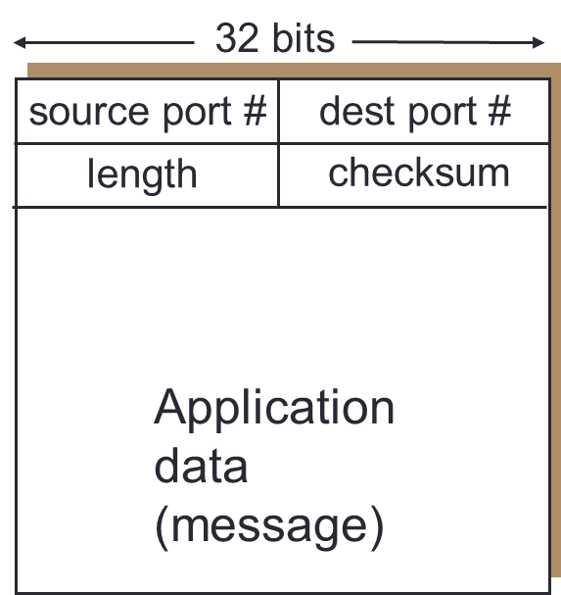
Transport Layer - UDP
MUX/DeMUX
Best effort
Connectionless
Send independent datagrams
Drop error datagrams
No congestion control

Slide 16
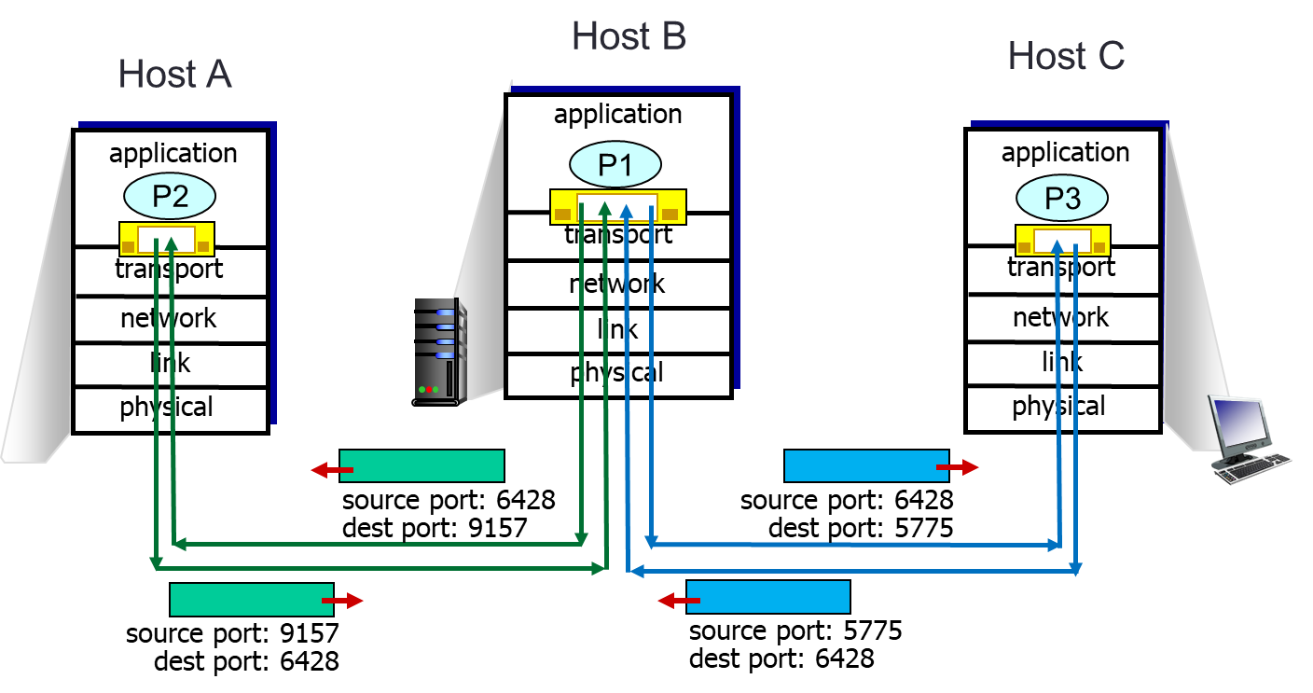
Transport Layer - UDP
Each process uses a port to communicate with other process
One process can communicate with several others using UDP

Slide 17
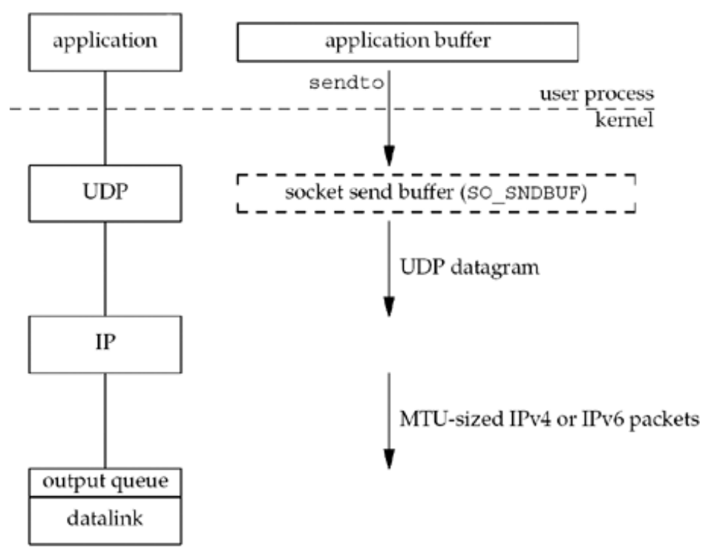
UDP Write

Slide 18
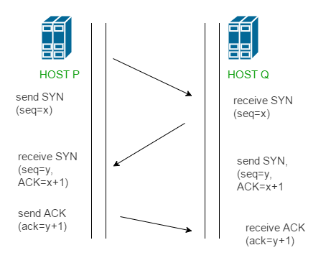
Transport Layer - TCP
Connection oriented protocol
  3-step connection opening
Reliable protocol
  Re-transmission on error
Flow control
Congestion control

Slide 19
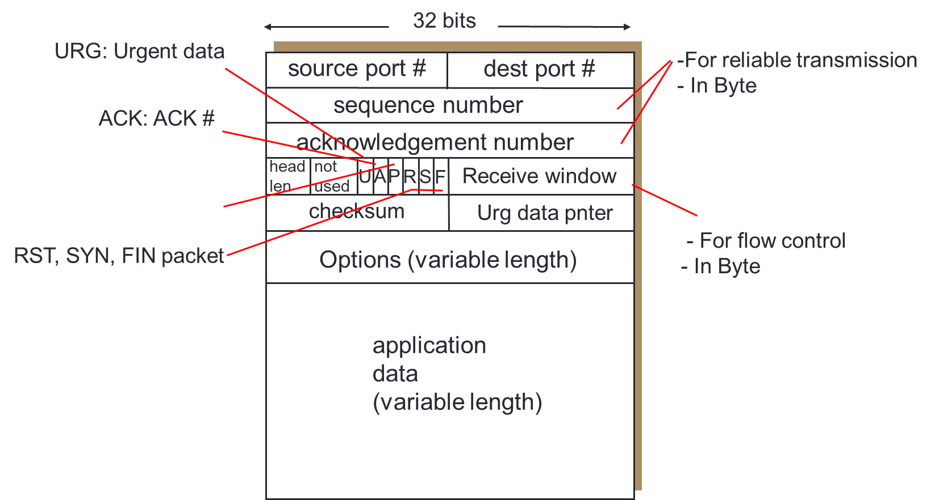
Transport Layer - TCP

Slide 20
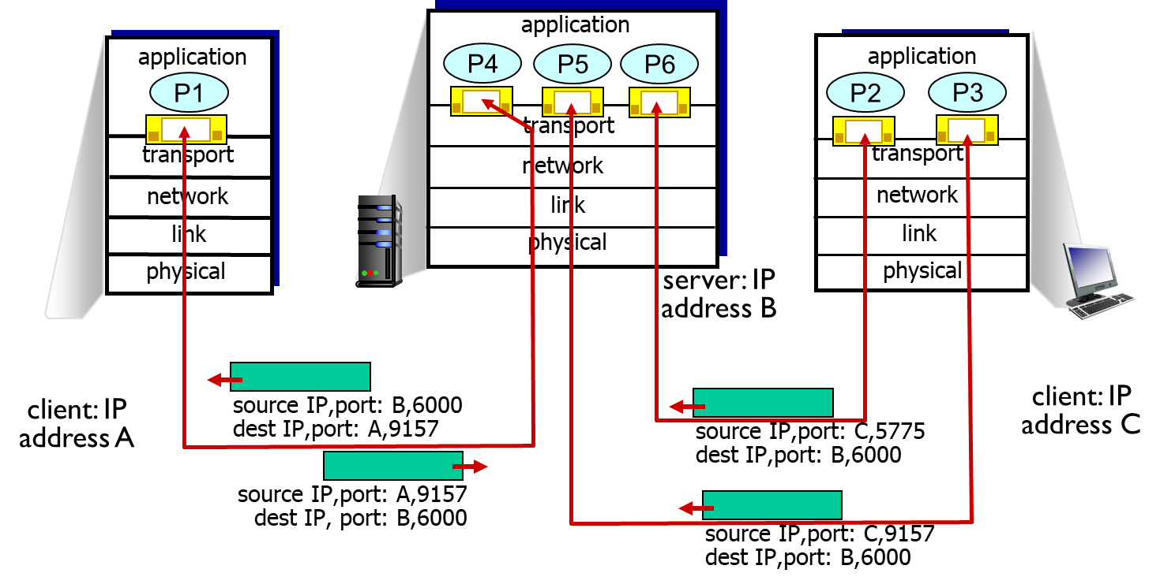
Transport Layer - TCP

Slide 21
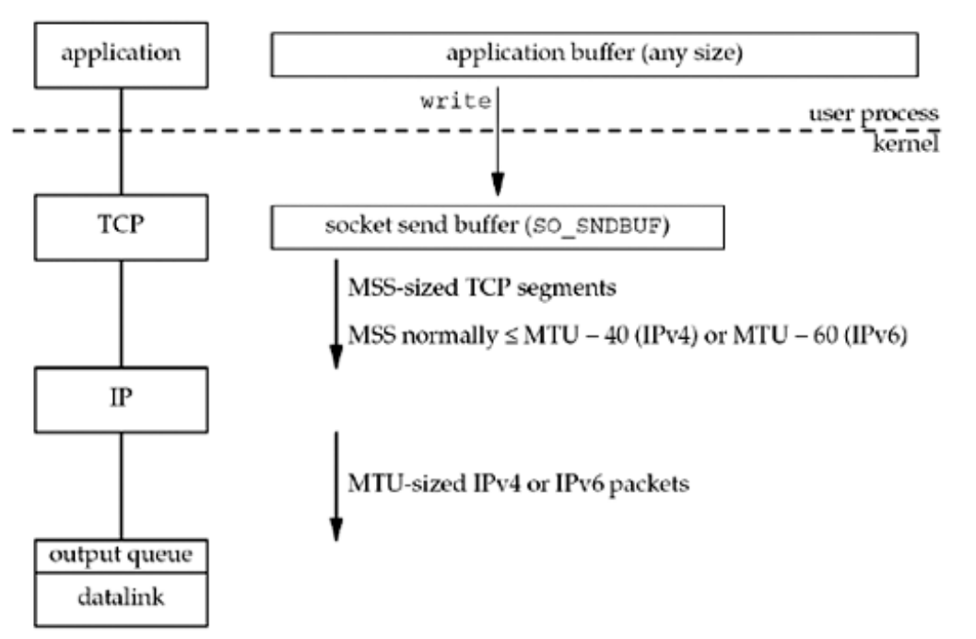
TCP Write

Slide 22
Network application models
Client/Server
Peer-to-peer
Hybrid

Slide 23
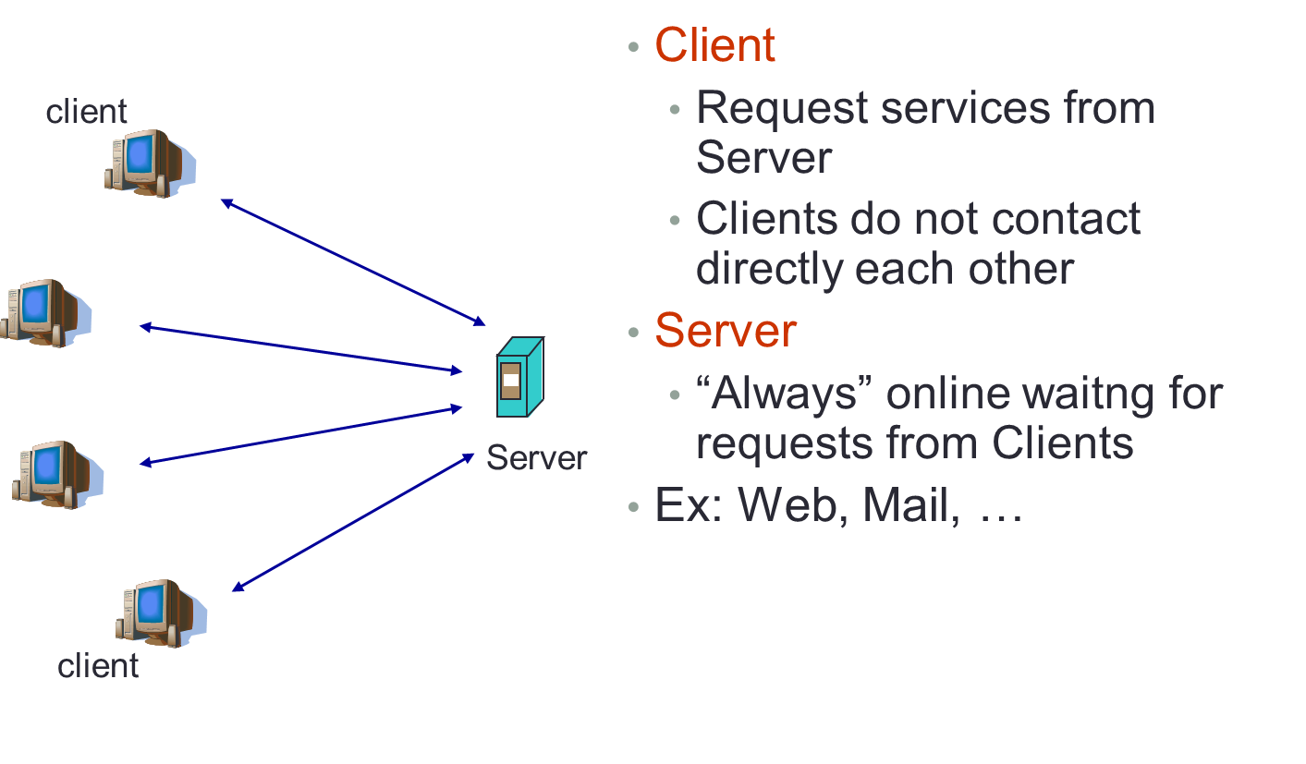
Network application models

Slide 24
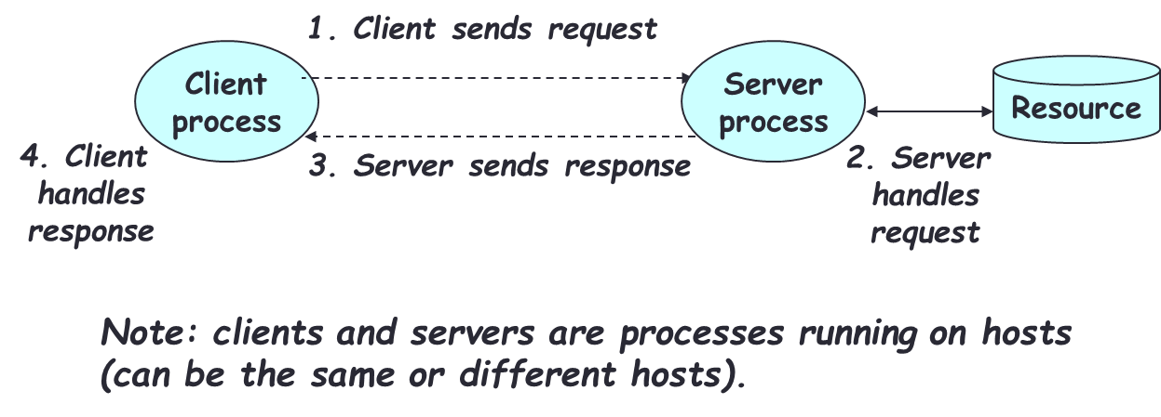
Network application models
Client asks (request) – server provides (response)
Typically: single server - multiple clients
The server does not need to know anything about the client
The client should always know something about the server
  Where it is located (IP Address, Domain Name)
  Service port to connect (80, 443, 20, 21, etc.)

Slide 25
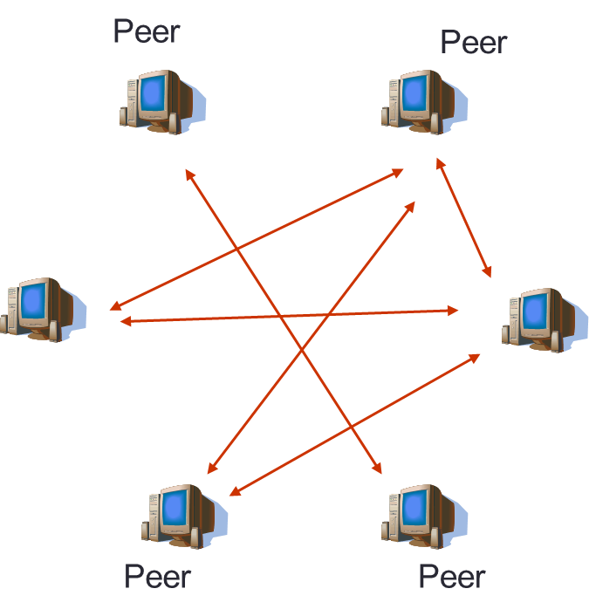
Network application models
No central server
Peers have equal role
Peers can communicate directly to each other
Peers do not need to be always online
E.g. Gnutella, Emule

Slide 26
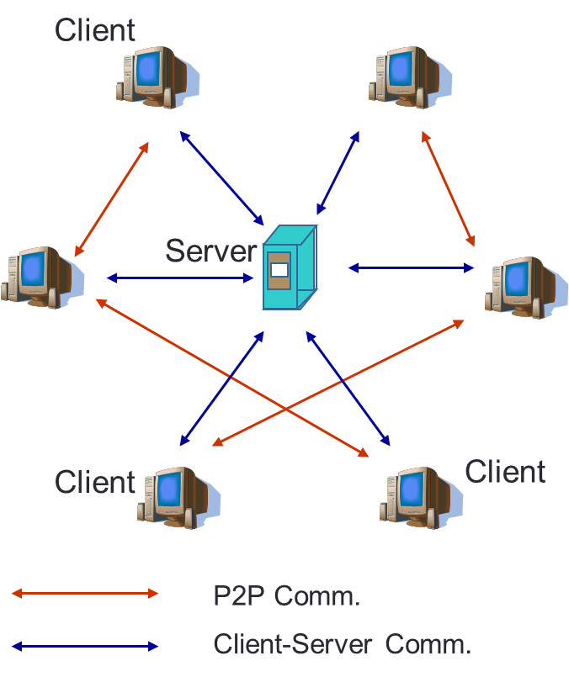
Network application models
Central server manages user accounts, authentification, stores data for searching process …
Clients communicate directly after authentication process
E.g., Skype
  Server manages login process.
  Messages, voices are transmitted directly between servers.

Slide 27
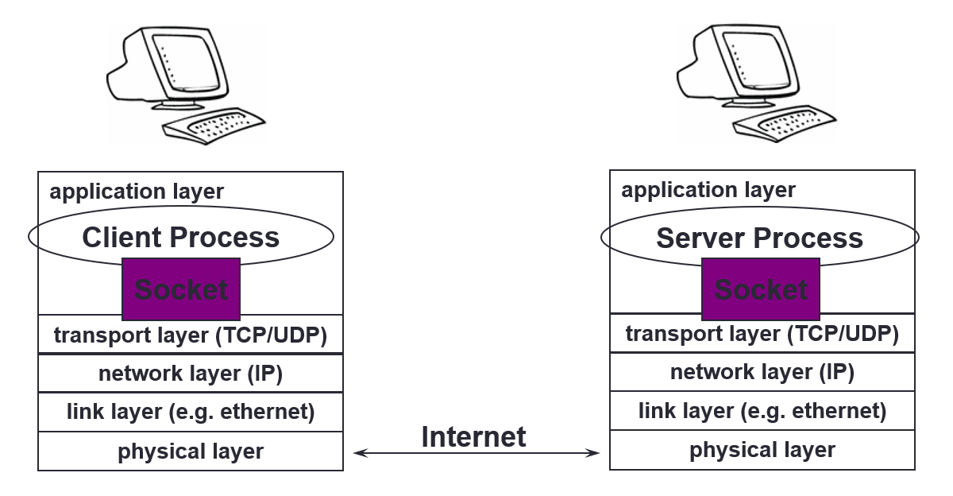
Socket
Sockets as means for inter-process communication (IPC)
The interface that the OS provides to its networking subsystem

Slide 28
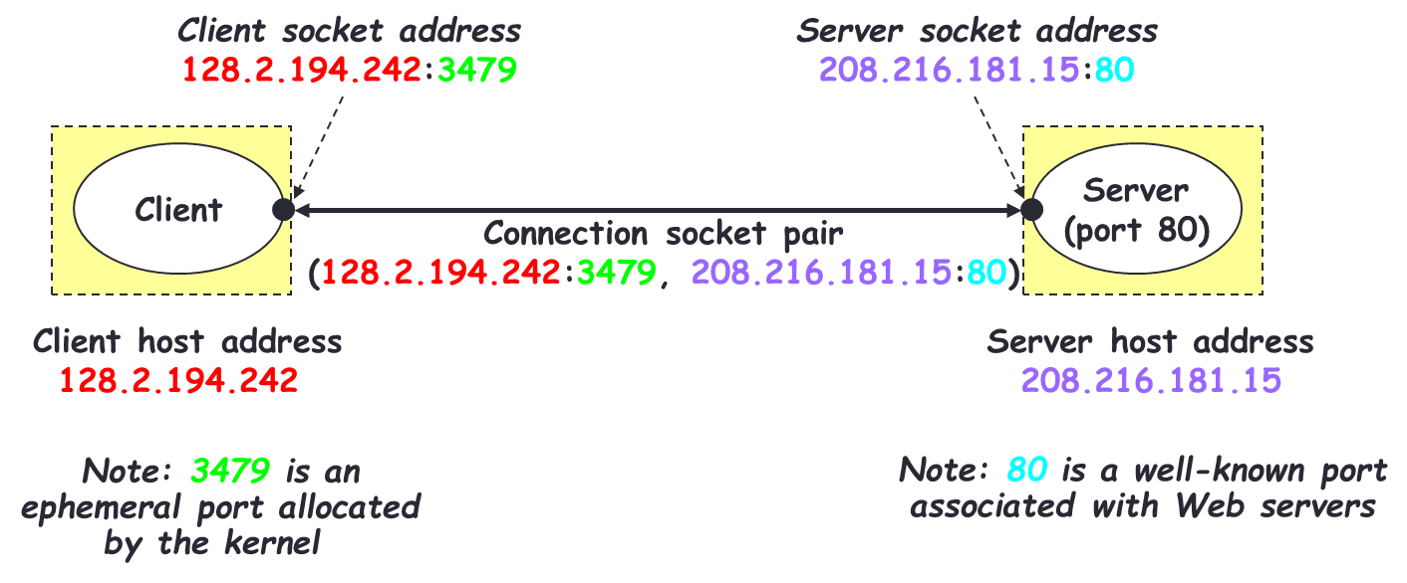
Socket - Connection

Slide 29
Socket - Connection
Need to open two sockets of both sides
  Client socket
  Server socket
Client application send/receive data to server through client socket
Server application send/receive data to client through client socket
Make two sockets talking to each other

Slide 30
Q&A

